Slide 1
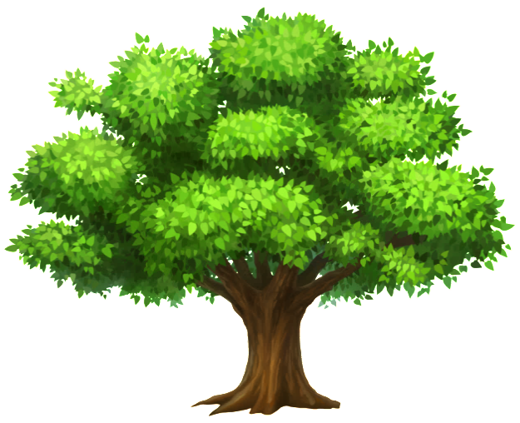

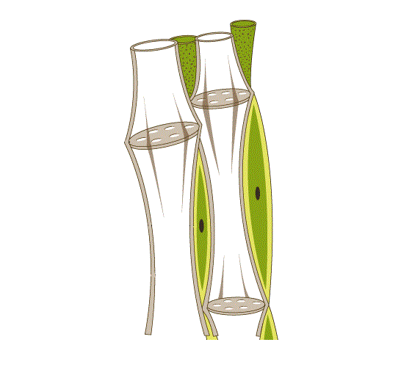
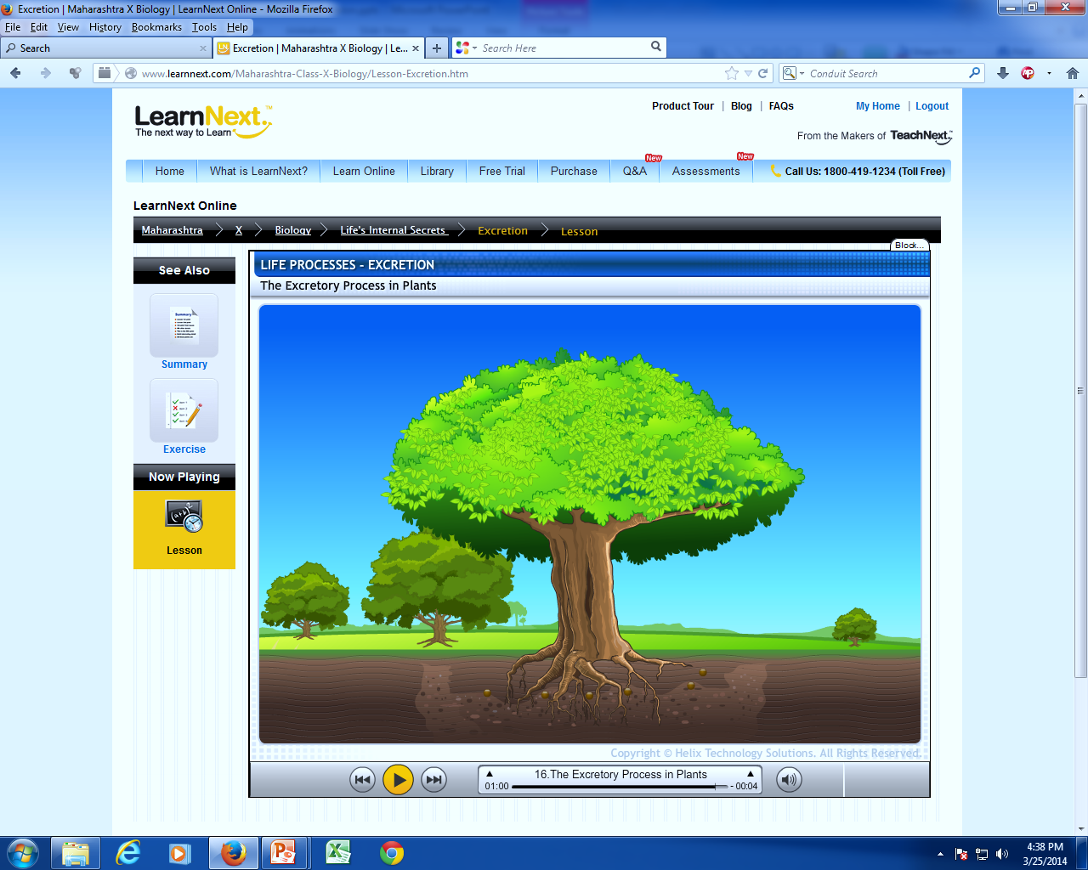
Vascular tissue
2. Phloem :
Phloem transports food i.e. sugars and amino acids from leaves to other parts of the plants such as stems and roots.
It is made up of 4 types of cells :
Food
S
A
A
S

Slide 2
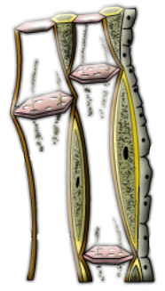
i. Sieve tubes :
They are tubular cells with perforated walls and arranged end to end.
The end walls of the sieve tubes have perforated walls.
Materials can move through perforated walls from one adjacent cell to another.
Having small holes
End walls
Sieve tubes

Slide 3
ii. Companion cells :
These are the cells that surround the sieve tube elements.
Companion cells are living and keep their nuclei and other organelles through out their life time.
Companion cells are believed to control the activity of sieve tube elements.
Companion cell
Nucleus

Slide 4
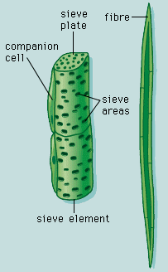
iii. Phloem fibres :
These are elongated tapering cells, which are found particularly in the stem.
The cell walls are thickened.
It gives mechanical strength to the plant.
Phloem fibres are dead cells.

Slide 5
iv. Phloem parenchyma :
These cells are alive and filled with cytoplasm.
The cell walls are thin.
These cells form the packing tissue between all the other types of cells.
Phloem parenchyma stores compounds such as starch.
Phloem parenchyma

